Slide 1
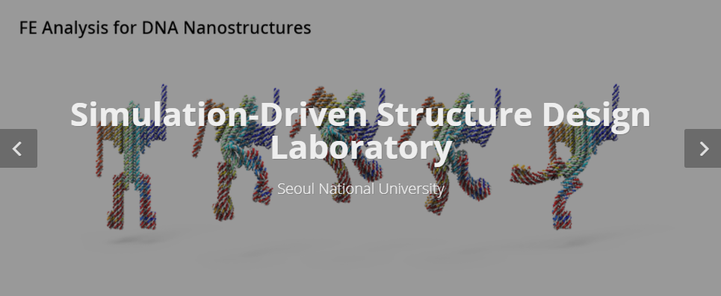
PINN Papers Summary
Jiwon Kang
MS-PhD Program of Mechanical Engineering
Seoul National University, South Korea

Slide 2
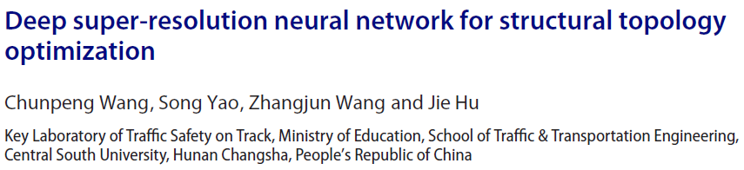
2. GOALS
1.
2.

Slide 3


Main Idea
Topology optimization based on SIMP method
2. GOALS
Predict optimized high resolution structure with multi boundary conditions
1.
2.
Super Resolution
Optimization with high resolution requires
much more time compared to low resolution
Compute low resolution data and
Apply super resolution to get high resolution

Slide 4
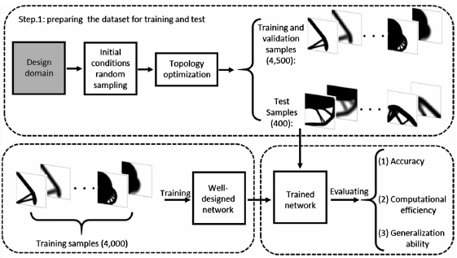
Methodology
2. GOALS
1.
2.

Slide 5
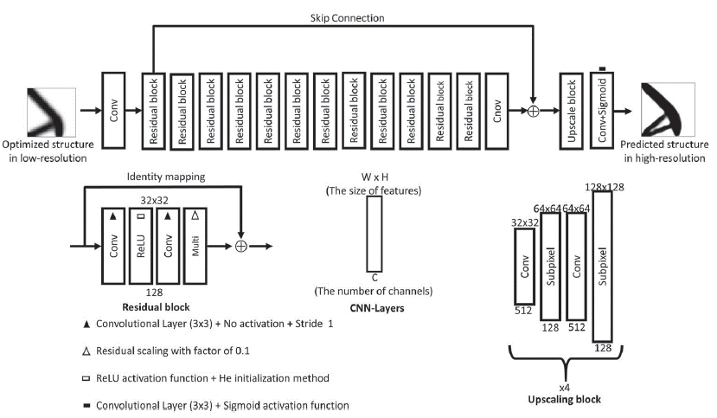
Methodology
1. Generating training/testing samples (+ data augmentation)
2. Super Resolution Network
2. GOALS
1.
2.
Use of
EDSR model

Slide 6

Methodology
3. Loss Function
2. GOALS
1.
2.
h: predicted structure, y: HR ,x: LR
4. Evaluation metrics
pixel accuracy, volume(mass) fraction, structural compliance
Compared with HR data

Slide 7
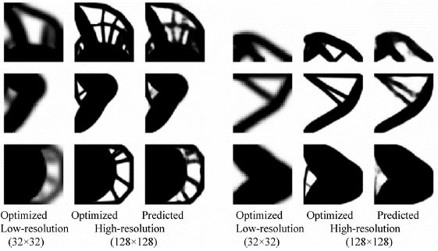
Result
2. GOALS
1.
2.

Slide 8
Pros and Cons
Pros
2. GOALS
- Fast computation of HR structures
- Can be developed to 3D topology optimization
1.
2.
Cons
- Difficult to predict under a completely new boundary condition

Slide 9

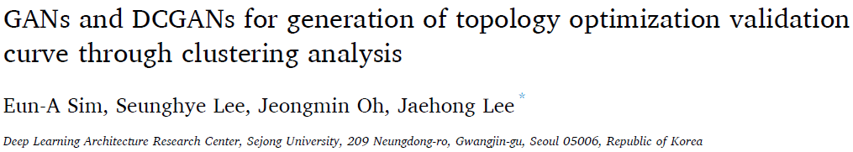
2. GOALS
1.
2.

Slide 10
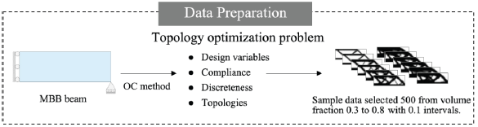
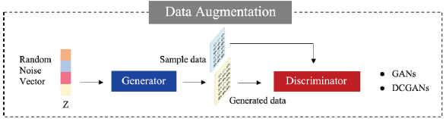
Methodology
Generate Topology optimization data with GANs
2. GOALS
1. Data preparation with OC method(optimization algorithm)
1.
2.
2. Data augmentation with GANs/ DCGANs

Slide 11
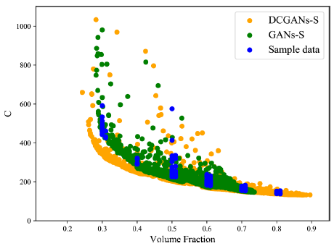
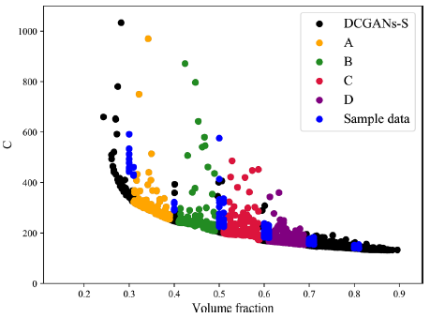
Methodology
3. Image filtering with sigmoid function
2. GOALS
0~0.5 value becomes 0/ 0.5~1 value becomes 1
1.
4. Clustering Analysis with K mean CA
2.
Divide sample data + generated data into groups with Volume Fraction (how dense the structure is)

Slide 12
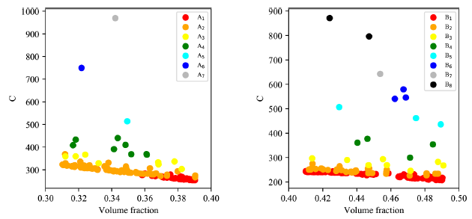
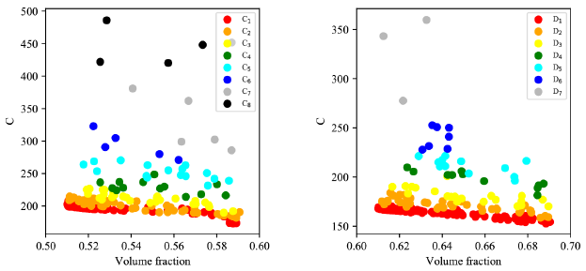
Methodology
4. Clustering Analysis with K mean CA
2. GOALS
From each groups apply K mean clustering analysis to find the best optimization items (red)
1.
-> Elbow method to find optimum K -> Divide into K groups(here 8) -> Find the best items
2.
Best optimization items are in other words valid data
-> With best compliance + minimum Mu (well discretized)

Slide 13
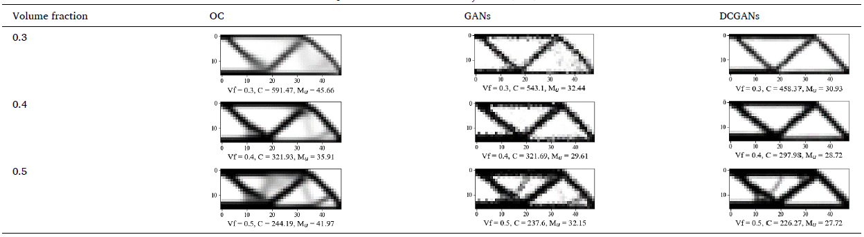
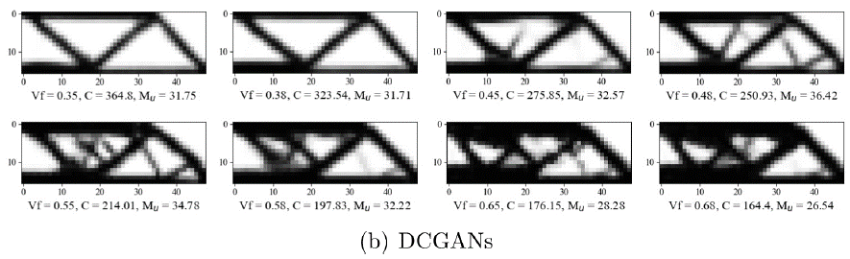
Results
Data generation with DCGANs show good results (For each volume fraction)
2. GOALS
1.
2.

Slide 14
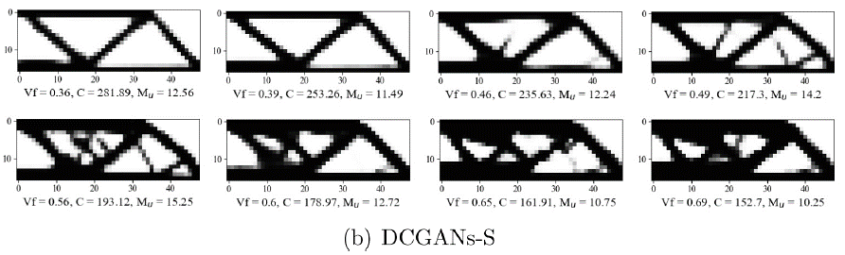
Results
Better discretized after sigmoid filter
2. GOALS
1.
2.

Slide 15
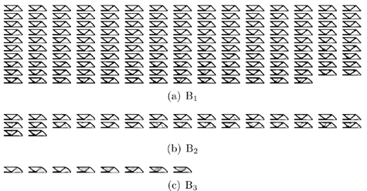
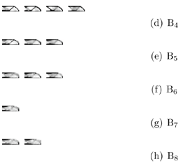
Results
Divided into 8 groups with Clustering Analysis -> B1 is the valid dataset (most discretized, compliance)
2. GOALS
1.
2.

Slide 16
Pros and Cons
Pros
2. GOALS
- Can generate useful data with GANs
- Very fast
- Can be used for Super Resolution dataset
1.
2.
Cons
- Disconnections in the image (can’t be seen in real world structures)

